Slide 1
CAP748:PROBABILITY AND STATISTICS (LAB)

Slide 2
Introduction to Googlesheets
Google Sheets is a free, web-based spreadsheet application that is provided by Google within the Google Drive service. The application is also available as a desktop application on ChromeOS, and as a mobile app on Android, Windows, iOS, and BlackBerry. Google Sheets allows users to edit, organize, and analyze different types of information. It allows collaborations, and multiple users can edit and format files in real-time, and any changes made to the spreadsheet can be tracked by a revision history.

Slide 3
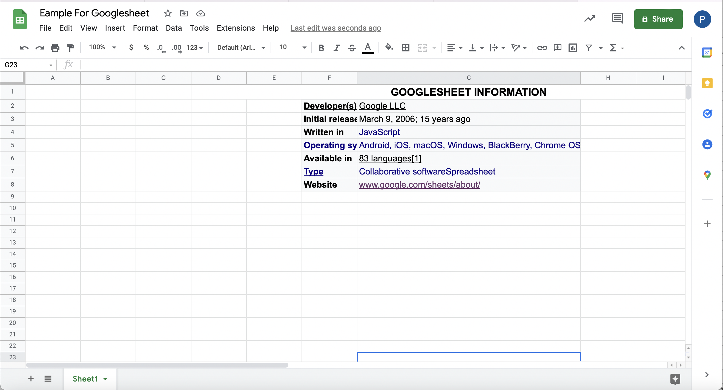

Slide 4
Features

Slide 5
1. Editing
One of the key features of Google Sheets is that it allows collaborative editing of spreadsheets in real-time. Rather than emailing one document to multiple people, a single document can be opened and edited by multiple users simultaneously. Users can see every change made by other collaborators, and all changes are automatically saved to Google servers. Google Sheets also includes a sidebar chat feature that allows collaborators to discuss edits in real-time and make recommendations on certain changes. Any changes that the collaborators make can be tracked using the Revision History feature. An editor can review past edits and revert any unwanted changes.
USER1
USER2

Slide 6
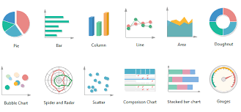
2. Explore
The Explore feature in Google Sheets was first introduced in September 2016, and it uses machine learning to bring additional functionalities. This feature provides a lot of information based on the data added to the spreadsheet, and it can auto-update itself depending on the selected data.
With the Explore feature, users can ask questions, build charts, visualize data, create pivot tables, and format the spreadsheet with different colors. For example, if you are preparing a monthly budget and you’ve added all the expenses to the spreadsheet, you can use the Explore feature to get the cost of specific expenses such as food, travel, clothing, etc. On the sidebar, there is a box where you can type the question, and it will return the answer. When you scroll down further in the Explore panel, there is a list of suggested graphs that are representative of the data entered in the spreadsheet, and you can choose between a pivot table, pie chart, or bar chart.

Slide 7
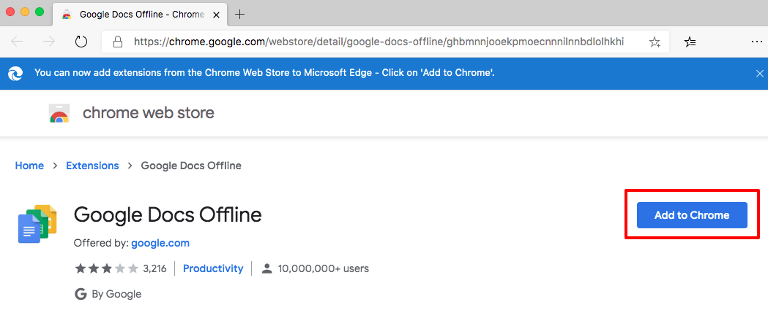
3. Offline editing
Google Sheets supports offline editing, and users can edit the spreadsheet offline either on desktop or mobile apps. On the desktop, users need to use the Chrome browser and install the “Google Docs Offline” Chrome extension to enable offline editing for Google Sheets and other Google applications. When using mobile, users need to use the Google Sheets mobile app for Android and iOS, which support offline editing.
STEPS TO WORK WITH OFFLINE EDITING
https://habr.com/en/post/493276/

Slide 8
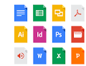
4. Supported file formats
Google Sheets supports multiple spreadsheet file formats and file types. Users can open, edit, save or export spreadsheets and document files into Google Sheets. Some of the formats that can be viewed and converted to Google Sheets include:
.xlsx
.xls
.xlsm
.xlt
.xltx
.xltxm
.ods
.csv
.tsv

Slide 9

5. Integration with other Google products
Google Sheets can be integrated with other Google products such as Google Form, Google Finance, Google Translate, and Google Drawings. For example, if you want to create a poll or questionnaire, you can input the questions in Google Forms, and then import the Google Forms into Google Sheets.

Slide 10
Common Terms
The following are some of the common terms associated with Google spreadsheets:
Cell: A single data-point.
Column: A vertical range of cells that runs down from the top of the sheet.
Row: A horizontal range of cells that run across from the left side of the sheet.
Range: A selection of multiple cells that runs across a column, row, or a combination of both.
Function: A built-in feature in Google Sheet that is used to calculate values and manipulate data.
Formula: A combination of functions, columns, rows, cells, and ranges that are used to obtain a specific end result.
Worksheet: Sets of columns and rows that make up a spreadsheet.
Spreadsheet: Entire document that contains Google Excel sheets. One spreadsheet can have more than one worksheet.

Slide 11

Shortcuts on Windows

Slide 12
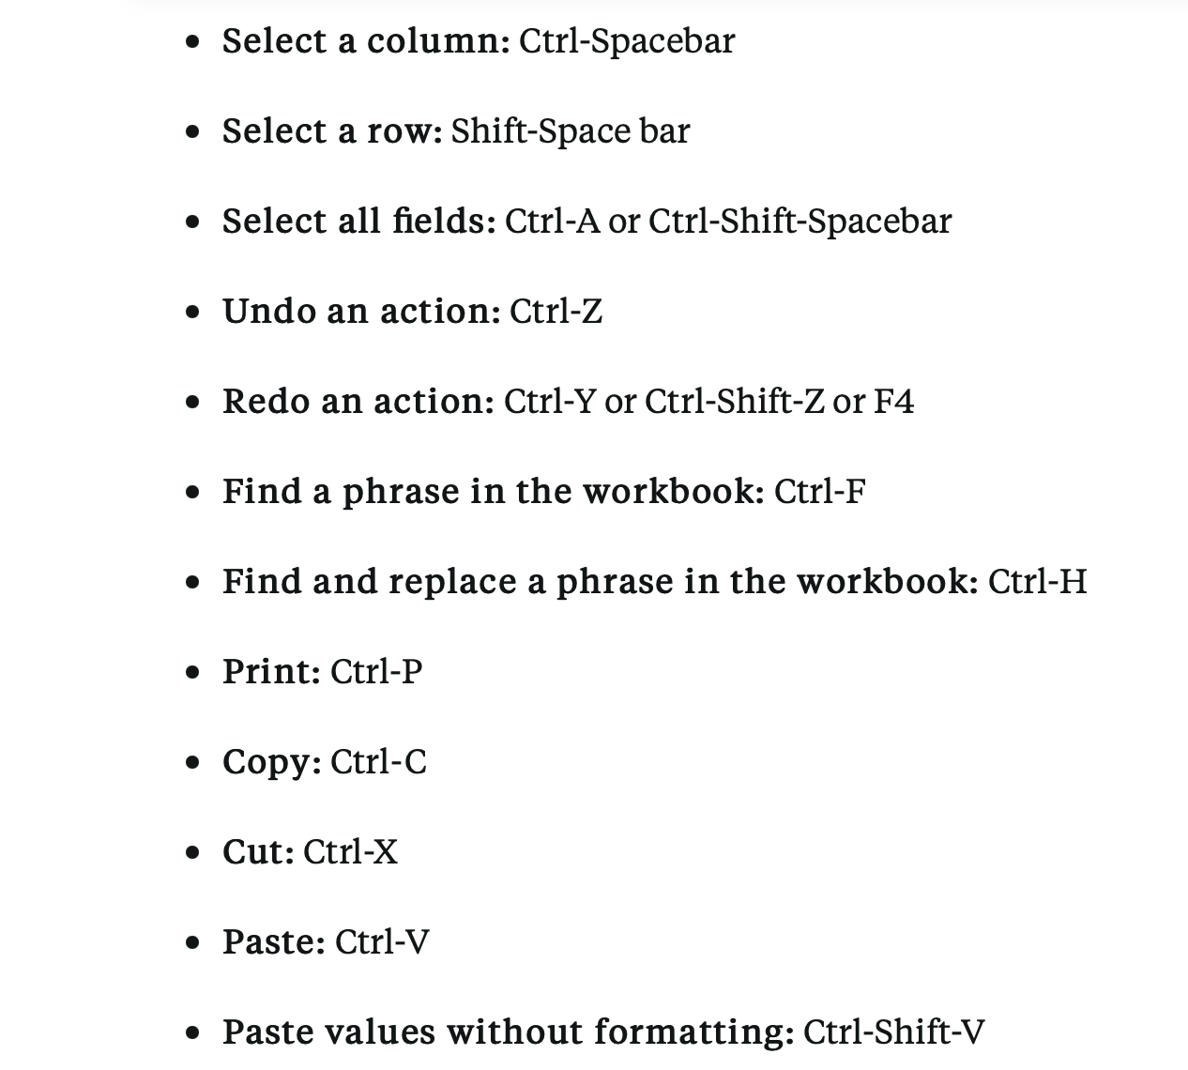
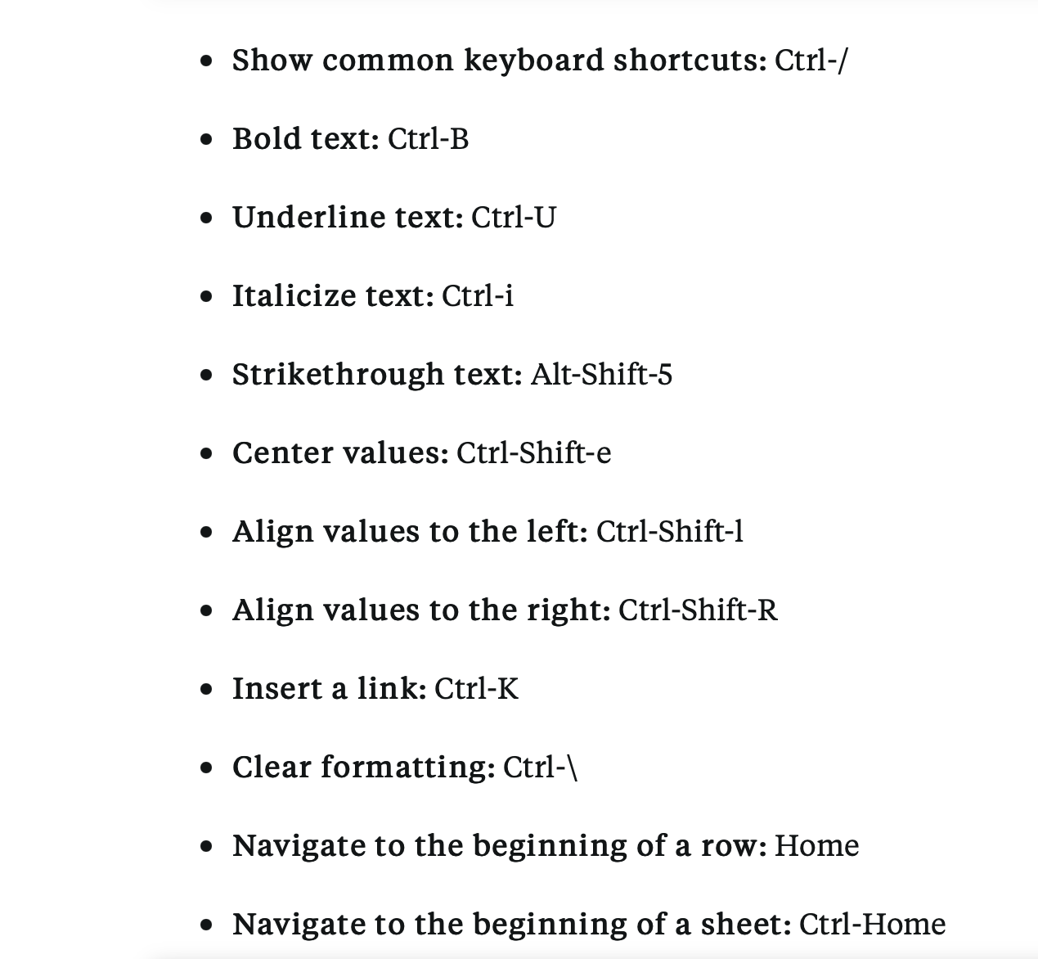

Slide 13
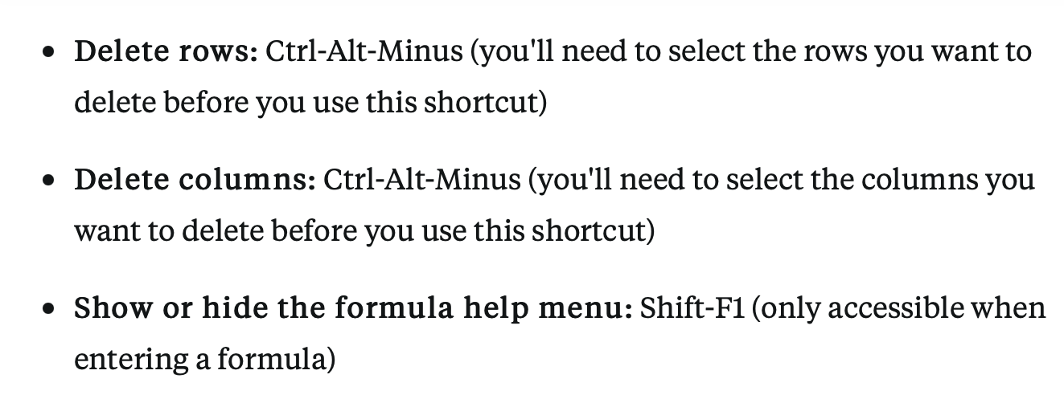
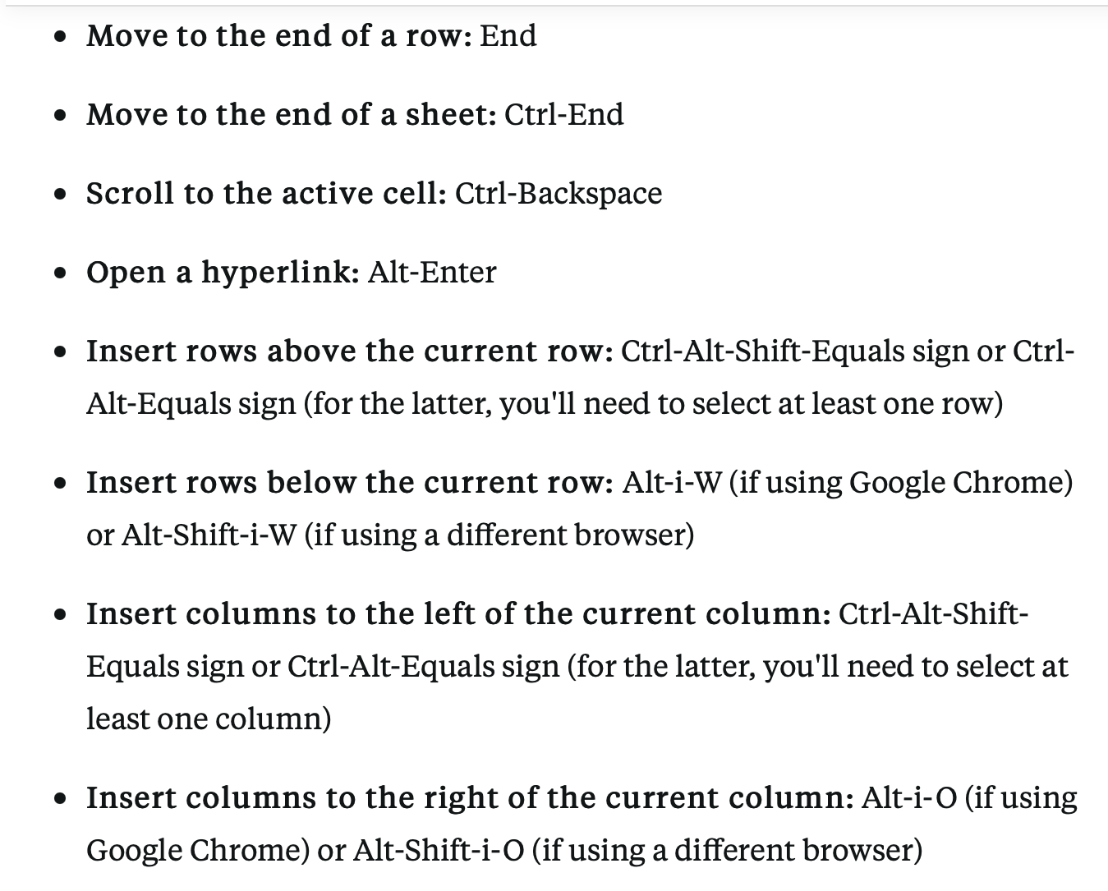

Slide 14

Shortcuts on Mac

Slide 15
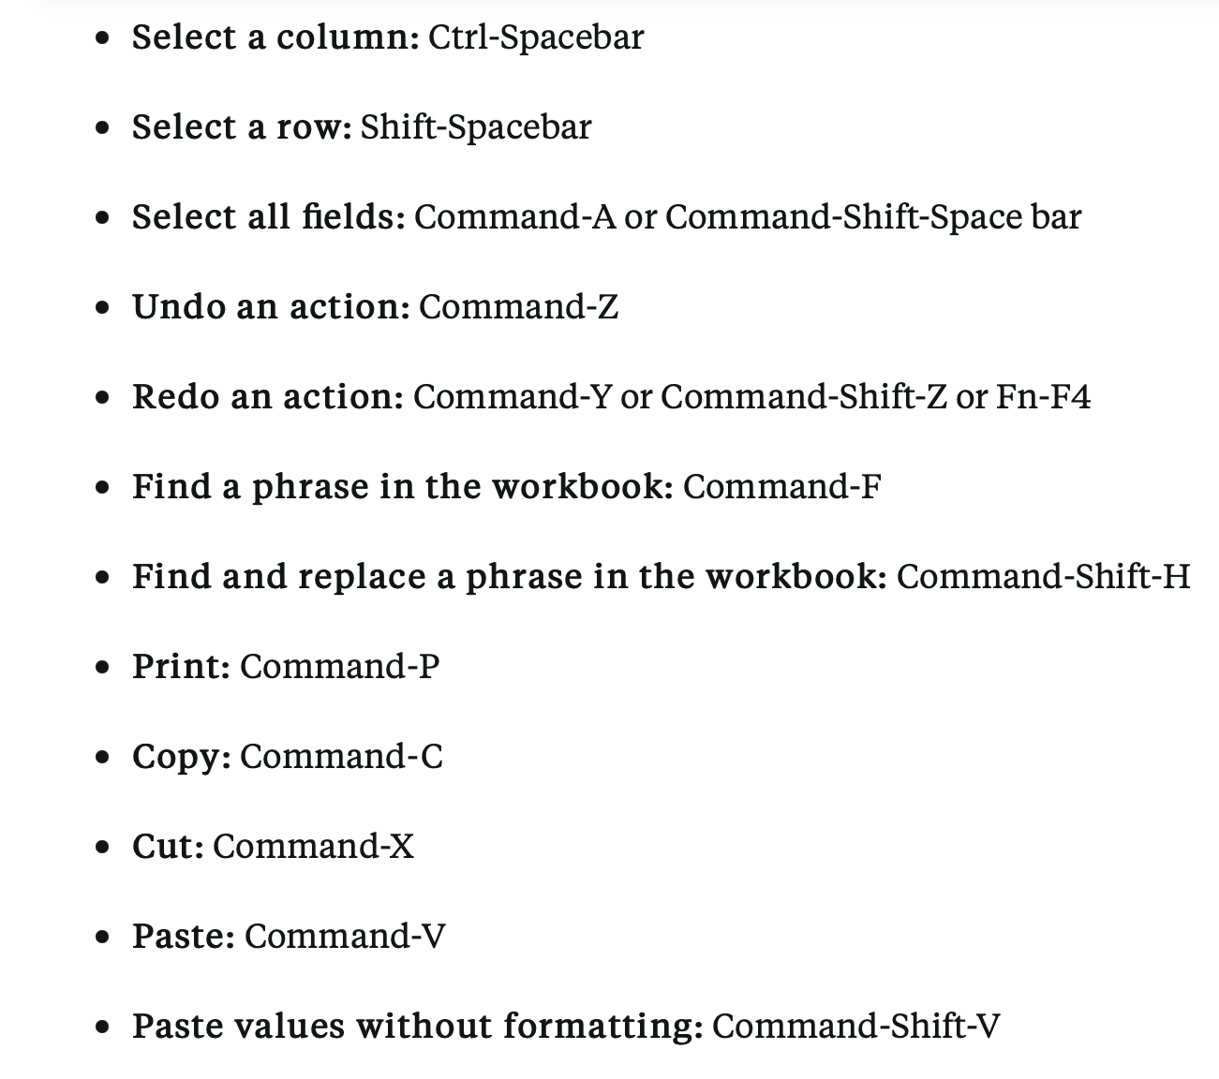
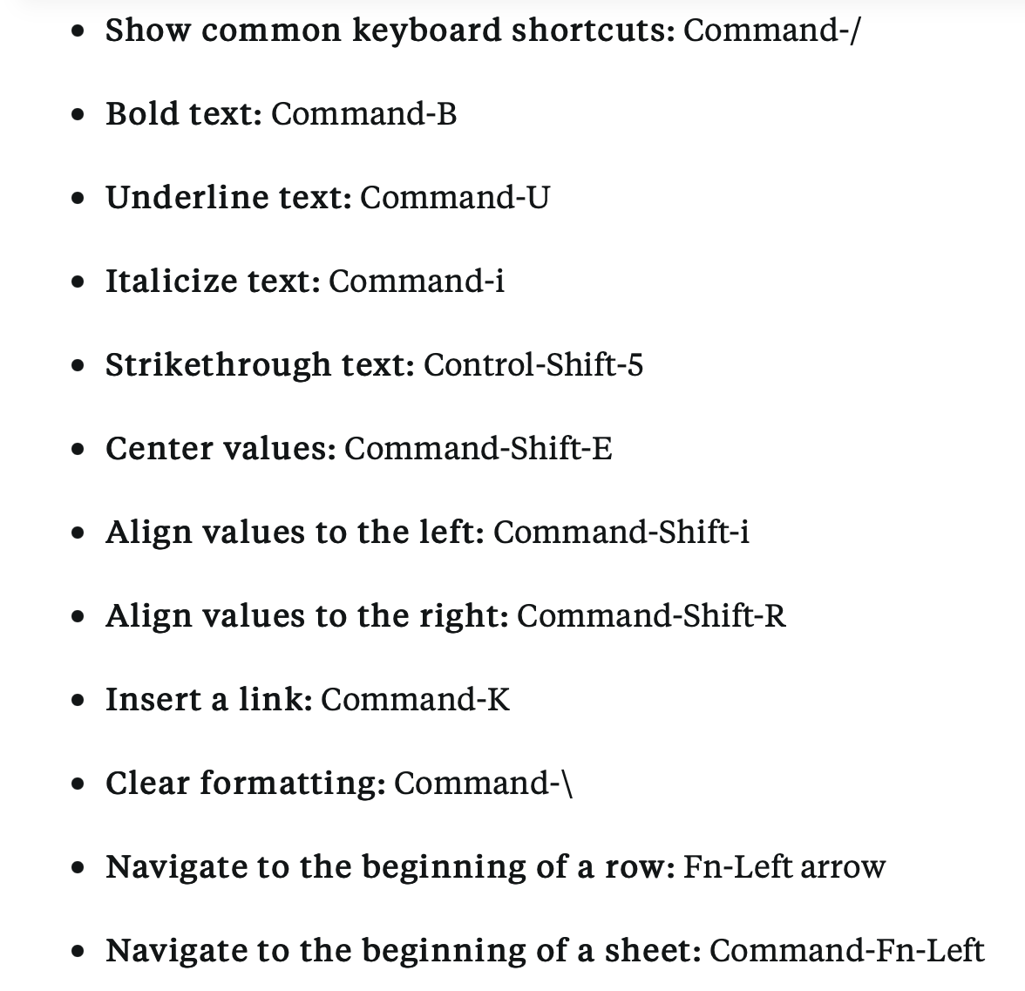

Slide 16
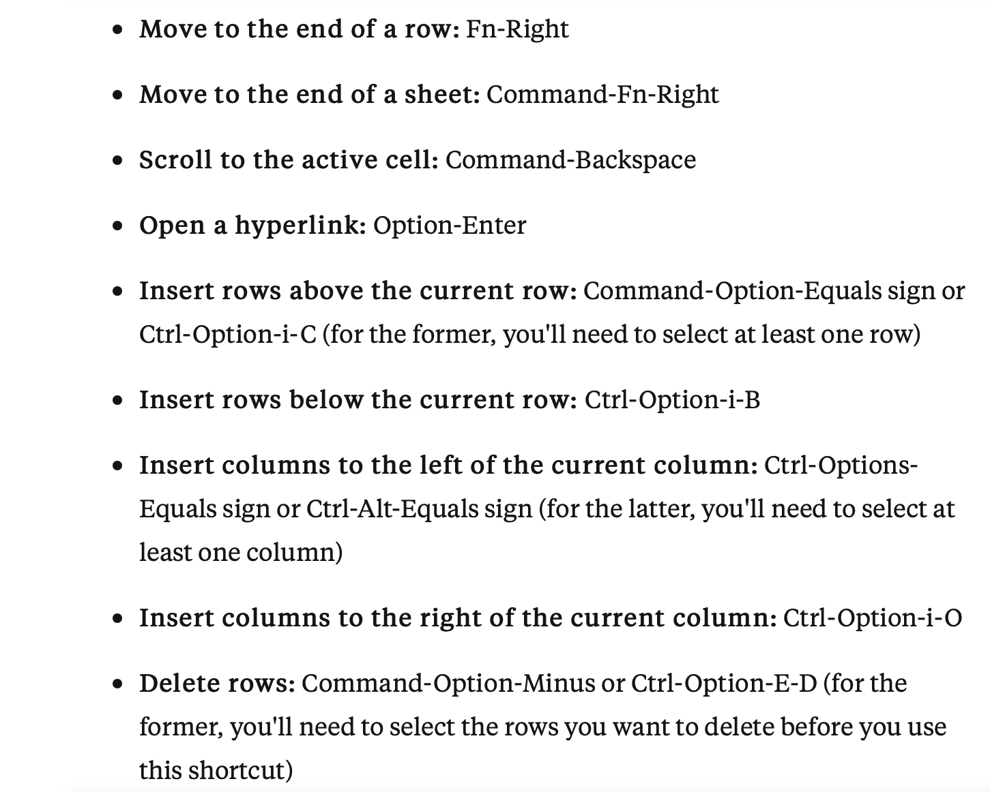
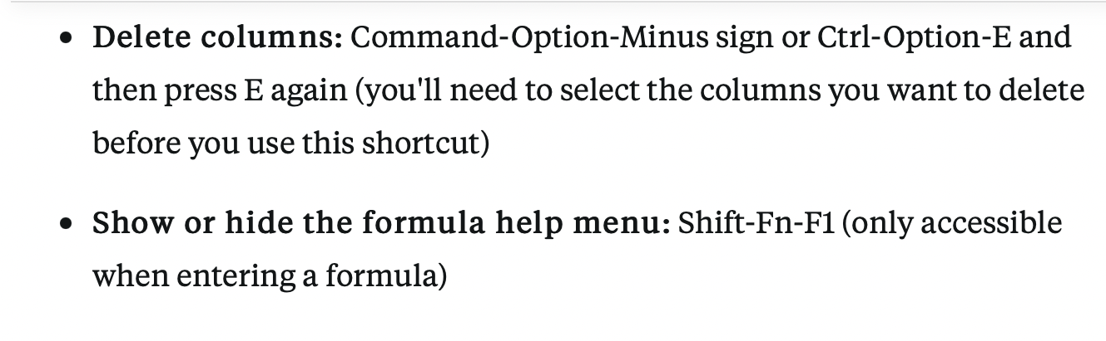

Slide 17
https://youtu.be/FIkZ1sPmKNw

